Slide 1
Capstone Project Presentation
Title: E-Commerce Business Analytics
Presented by: Nirmala Pochampally

Slide 2
Project Objectives
Analyze Shopee Brazil's sales data using Power BI to derive actionable insights on customer behavior, product sales, discounts, and shipping performance across various countries and customer segments.
Identify key trends and areas for improvement to maximize profitability and customer satisfaction.

Slide 3
Problem Statement
Limited visibility into customer purchase patterns and country-specific sales performance hinders strategic decision-making.
The impact of discounts and shipping delays on overall sales performance is not well understood.
A data-driven approach is needed to identify top-performing product categories and high-value customers.

Slide 4
Research Objectives
Derive insights from sales, customer, product, and shipping data.
Identify top-performing products and customers.
Understand the impact of discounts and shipping delays.
Propose actionable business strategies.

Slide 5
Data Understanding & Preparation
Data Understanding: Understand data structure and relationships.
Data Preparation:
Cleanse data by addressing missing values, correcting data types, and removing duplicates.
Create essential features like date tables and custom columns (e.g., Average Order Value, Discount Rate).

Slide 6
Data Preparation Steps
Imported multiple datasets into Power BI, including Customers, Orders, Products, Locations, and Shipping.
Data cleaning involved formatting dates and currencies, and normalizing column headers.
Calculated key performance indicators (KPIs) such as Total Sales, Average Order Value, Discount %, and Shipping Delay.
Merged datasets using unique identifiers like Customer ID and Product ID.

Slide 7
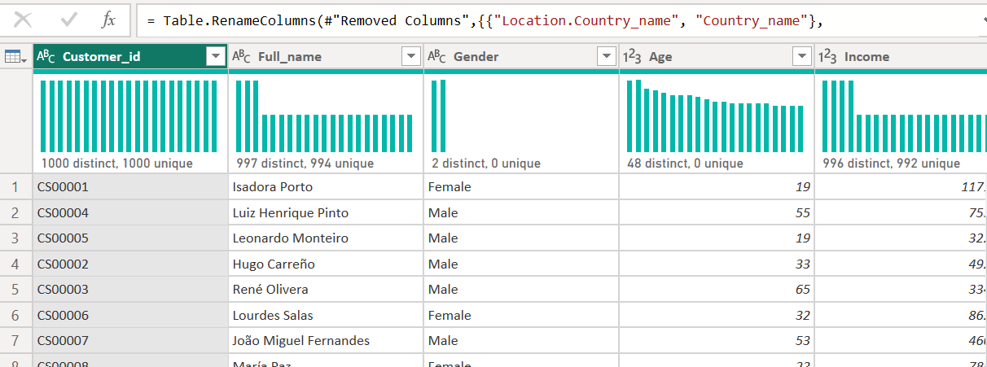
Customer Data Merging & Cleanup
Process: For customer analysis, first and last names were merged into a 'Full name' column for simplified demographic segmentation. Categorical data (e.g., Gender) was validated and cleaned, while numerical fields (e.g., Age, Income) were standardized.
Impact: This step helped organize customer information clearly, making it easier to group and analyze in the dashboards.

Slide 8
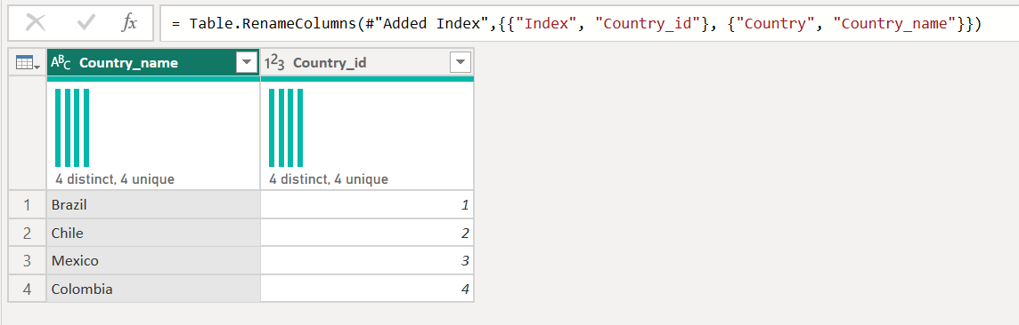
Created Location Dimension Table
Process: A dedicated 'Location' dimension table, including 'Country_id' and 'Country_name', was created to support lookup relationships with customer data.
Impact: This normalization facilitates scalable filtering and aggregation across geographies, crucial for region-wise analysis of shipping costs and sales.

Slide 9
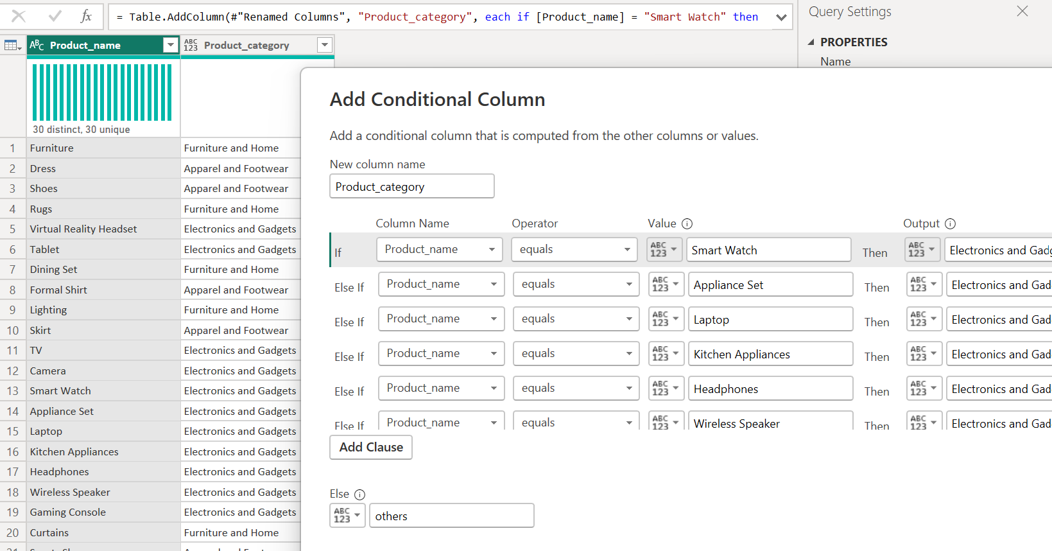
Categorized Products Using a Conditional Column
Process: To enhance product insights, a 'Product_category' calculated column was created using Power Query's conditional logic, based on 'Product_name'.
Impact: Products were grouped into logical categories such as 'Electronics and Gadgets,' 'Furniture and Home,' and 'Apparel and Footwear,' enabling clear visual storytelling in the dashboard.

Slide 10
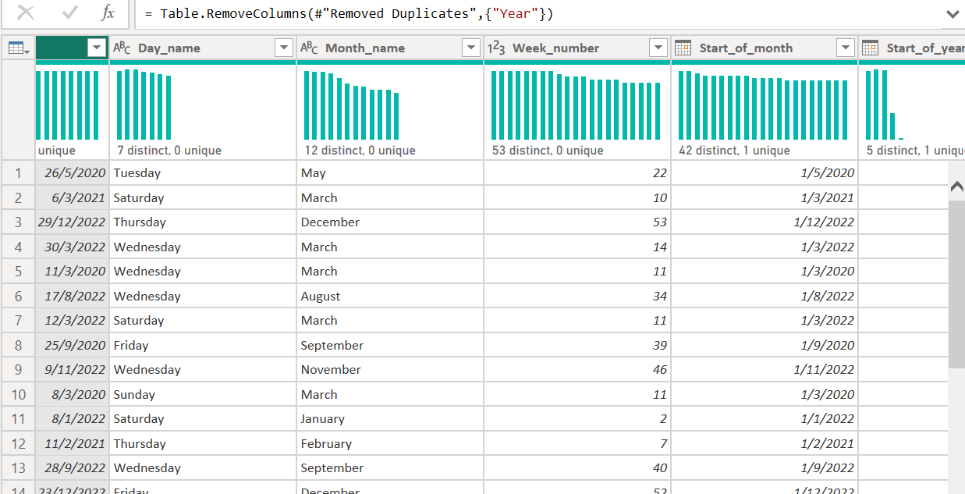
Structured & Transformed the Date Table
Process: A strong date table was created to help break down data by time and spot trends easily.
Impact: Custom columns (e.g., Year, Month_name, Week_number, Day_name) were derived to enable temporal comparisons, such as sales trends by month, order delays by day, and annual revenue.

Slide 11
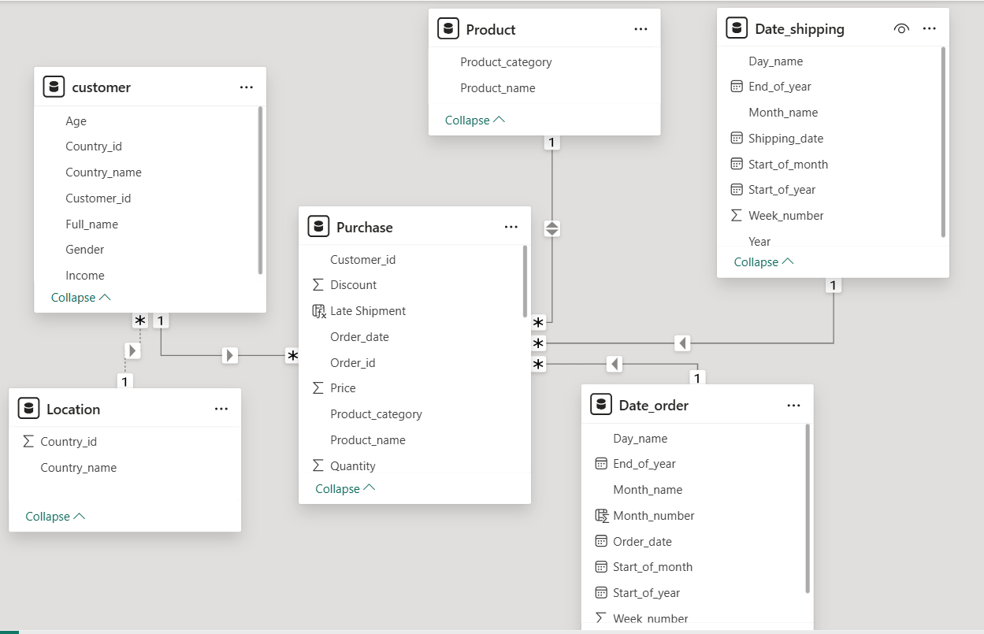
Created a Star Schema Data Model
Process: The data was organized into a clean Star Schema. The 'Purchase' table serves as the central fact table, connected via primary keys to 'Customer,' 'Product,' 'Date_order,' 'Date_shipping,' and 'Location' dimension tables.
Impact: This model enhances performance, simplifies DAX calculations, and ensures report scalability and clarity.

Slide 12
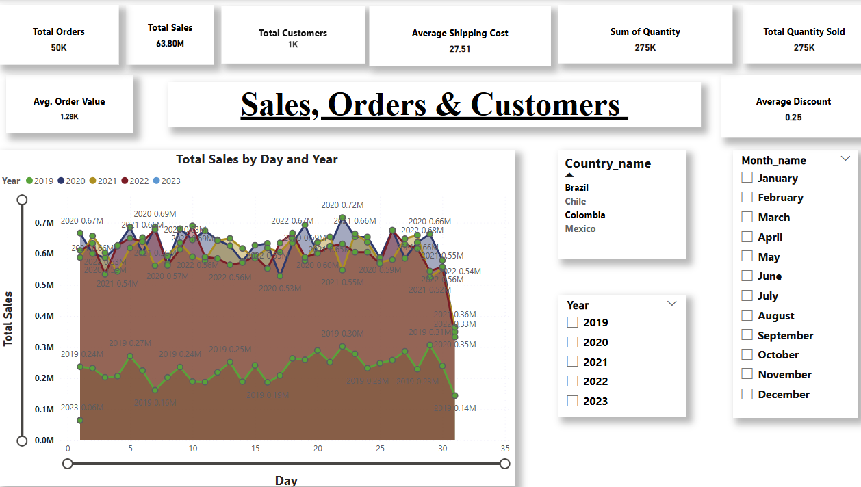
Dashboard 1: Sales, Orders & Customers

Slide 13
Dashboard 1: Sales, Orders & Customers
Overview: Dashboard 1 provides a data-driven overview of Shopee Brazil’s business performance. It explores key trends across sales, customers, shipping operations, and discount effectiveness to identify growth opportunities and strategic priorities.
Key Metrics: Shopee Brazil recorded 1,000 total orders generating 1.52 million in revenue. The platform served over 730 unique customers, with an average shipping cost of 27.99 and an average order value of 1.21K. Sales peaked around mid-month, as shown in the day-wise trend.

Slide 14
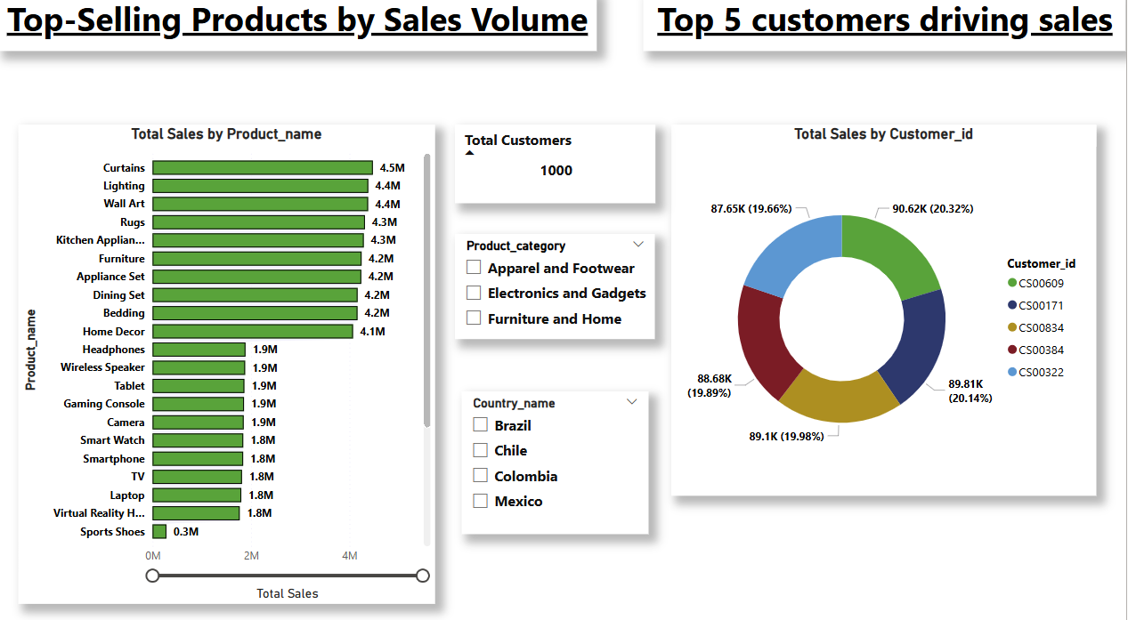
Dashboard 2: Top-Selling Products & Customers

Slide 15
Dashboard 2: Top-Selling Products & Customers
Product Performance: Products like Kitchen Appliances and Appliance Sets lead in sales volume and revenue.
Customer Insights: Notably, just 5 customers contribute a significant share of sales, with each driving 20% or more individually. This highlights a dependency on key buyers and the potential for loyalty and retention strategies.

Slide 16
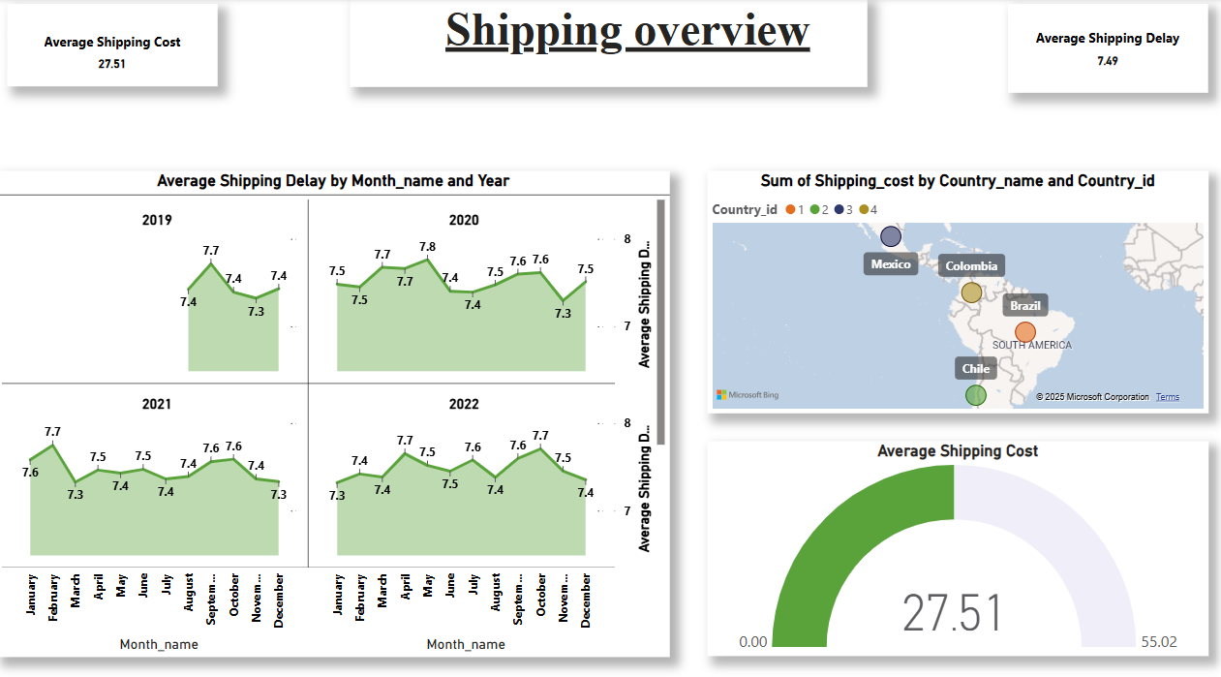
Dashboard 3: Shipping Overview

Slide 17
Dashboard 3: Shipping Overview
Overview: Dashboard 3 provides an overview of shipping performance, showing average shipping cost and average shipping delay across different months and years. It also illustrates shipping costs by country.

Slide 18
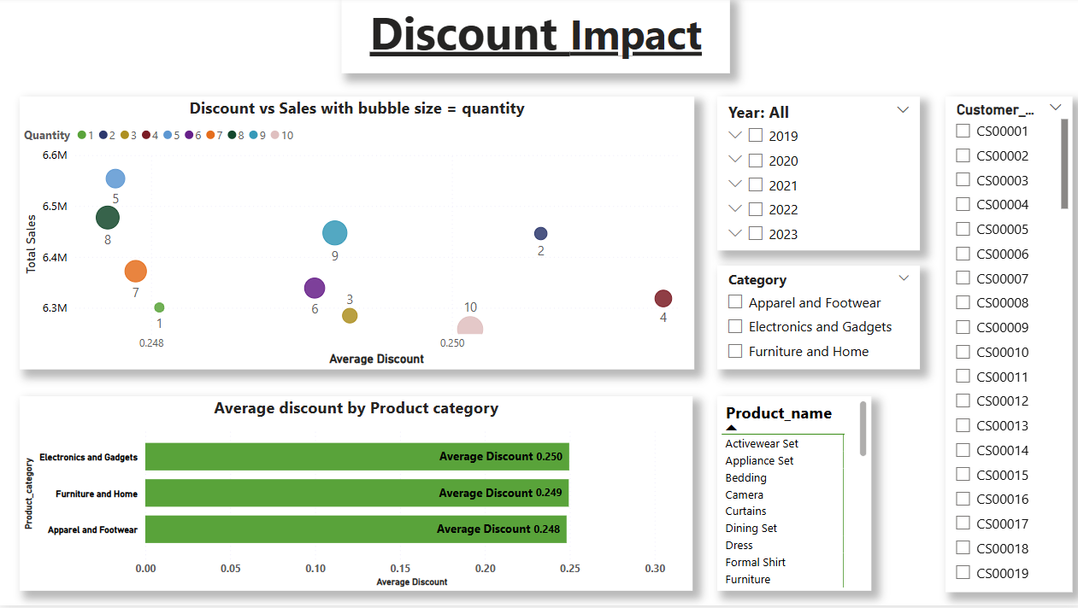
Dashboard 4: Discount Impact

Slide 19
Dashboard 4: Discount Impact
Analysis: This scatter plot evaluates the relationship between discounts and sales performance, with each bubble representing a product’s performance, sized by quantity sold.
Insights: Some clusters indicate that modest discounts (around 0.25) still result in high sales. 'Electronics and Gadgets' appears to benefit from price sensitivity. This analysis reveals where discounts effectively drive volume versus eroding margins.

Slide 20
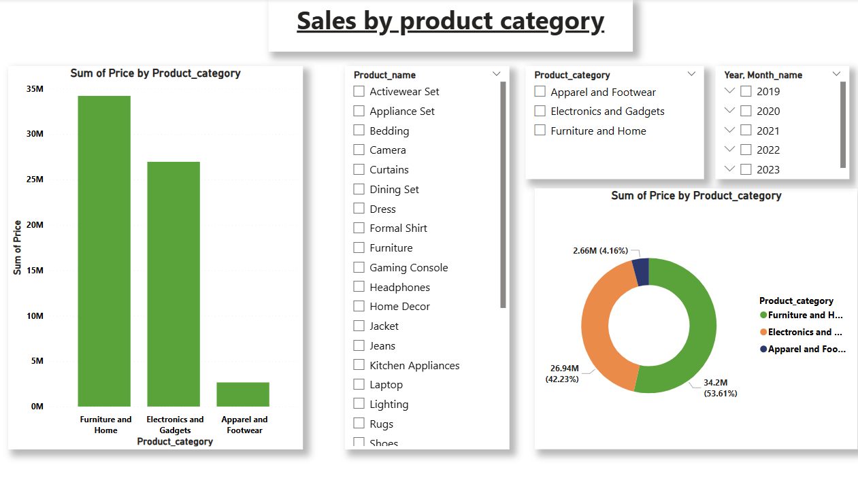
Dashboard 5: Sales by Product Category

Slide 21
Dashboard 5: Sales by Product Category
Revenue Distribution: This breakdown shows how revenue is distributed by product category. Furniture and Home leads in total revenue contribution, followed by Electronics and Gadgets.
Visual Summary: A complementary pie chart visualizes this mix, with Furniture accounting for 53% of total sales. This insight helps prioritize category-level promotions and inventory planning.

Slide 22
Executive Summary & Key Insights
Top-Performing Categories: Electronics & Gadgets and Furniture & Home are the leading revenue contributors.
Customer Loyalty: Top 5 customers generate significant recurring revenue, indicating the potential for loyalty and retention strategies.
Shipping Optimization: Shipping delays are mostly consistent, with opportunity to optimize costs by region.
Discount Effectiveness: Discounting helps boost quantity sold but requires margin balancing.

Slide 23
Action Plan
Targeted Marketing: Expand winning product lines and implement targeted marketing campaigns for best-selling categories.
Logistics Review: Explore and optimize logistics partners to reduce shipping costs and improve delivery efficiency.
Customer Segmentation: Refine customer segmentation to unlock further value and foster loyalty through tailored strategies.

Slide 24
Project Conclusion
This analysis for Shopee Brazil successfully illuminated key areas of e-commerce performance. Identified Electronics & Gadgets and Furniture & Home as top-selling categories driving significant revenue. Key customers contribute a major share of sales, highlighting the need for loyalty strategies. While shipping delays are manageable, cost optimization by region is possible. Discounts positively correlate with sales volume in specific segments, requiring careful margin balancing. Moving forward, we recommend targeted marketing on winning product lines, optimizing logistics, and refining customer segmentation to unlock further value and ensure sustained profitability.

